Slide 1
What is Web Service
A Web Service is can be defined by following ways:
It is a client-server application or application component for communication.
The method of communication between two devices over the network.
It is a software system for the interoperable machine to machine communication.
It is a collection of standards or protocols for exchanging information between two devices or application.

Slide 2
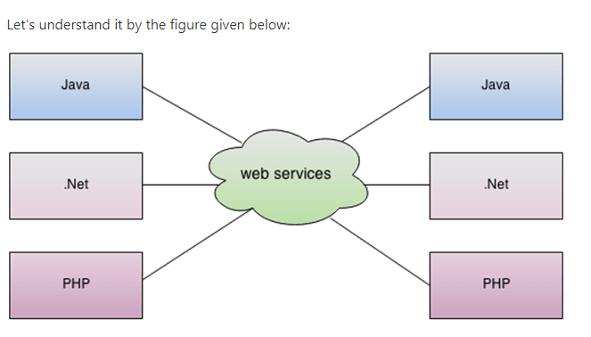

Slide 3
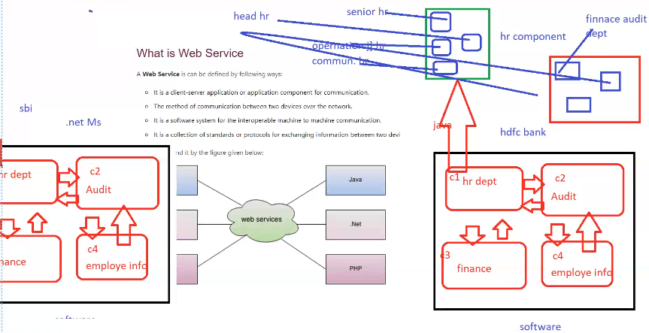

Slide 4
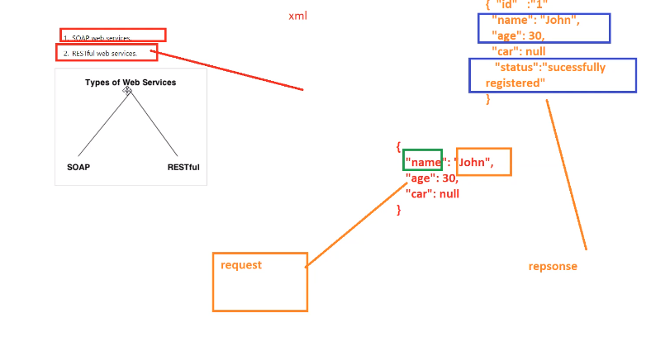

Slide 5
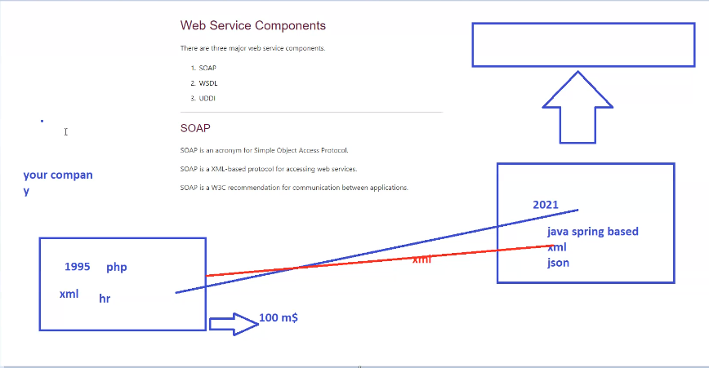

Slide 6
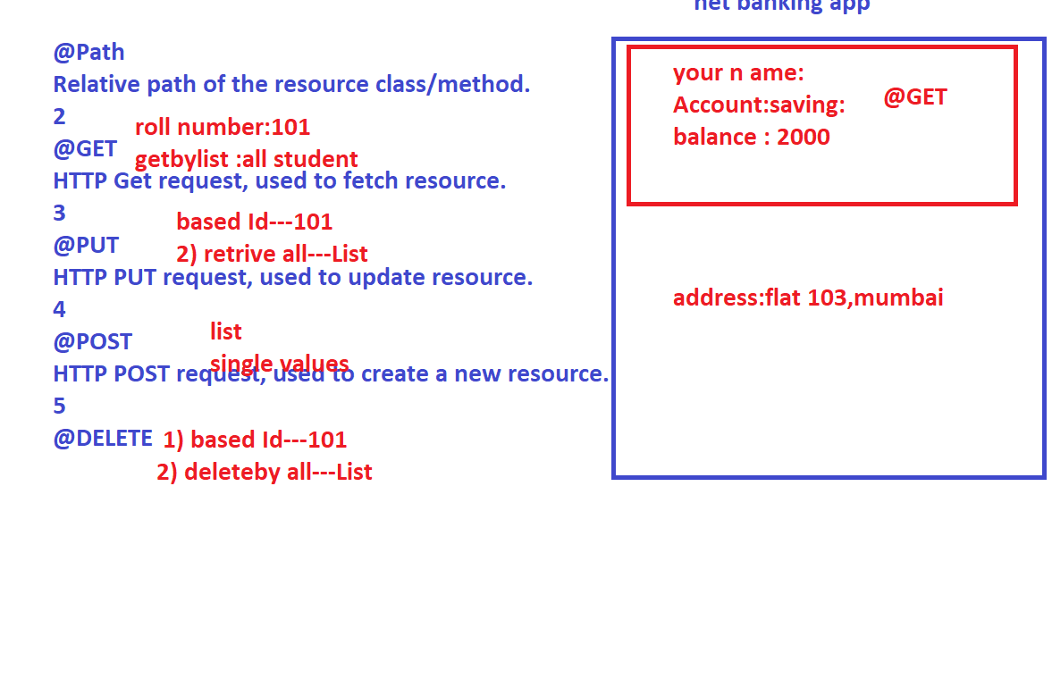
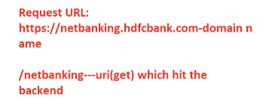

Slide 7
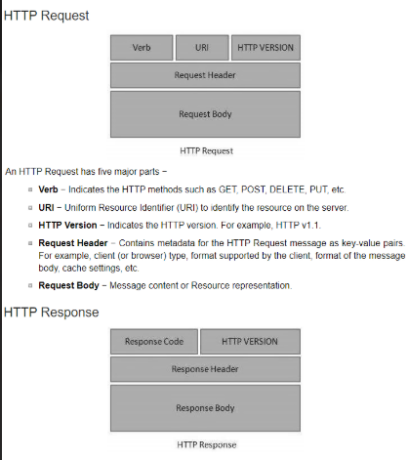

Slide 8
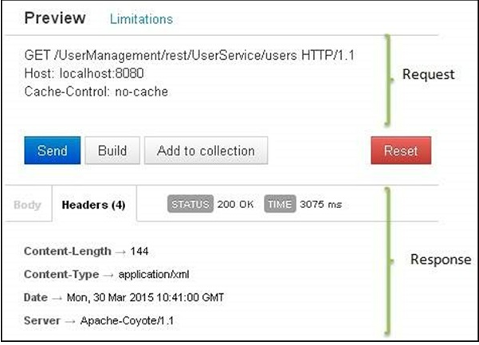

Slide 9
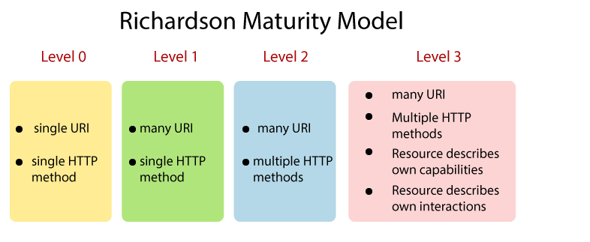

Slide 10
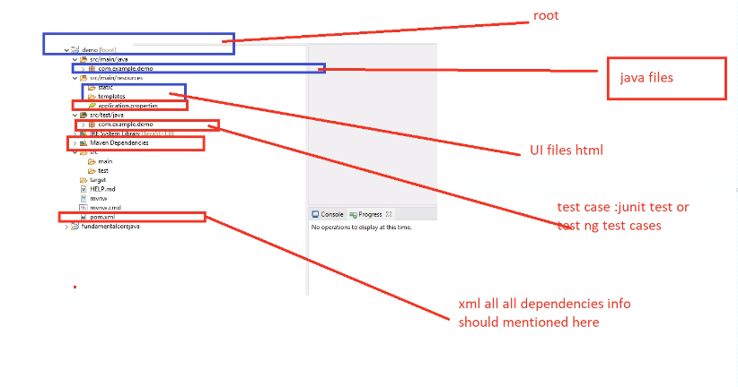
<dependency> <groupId>org.springframework.boot</groupId> <artifactId>spring-boot-starter-webflux</artifactId> </dependency>

Slide 11
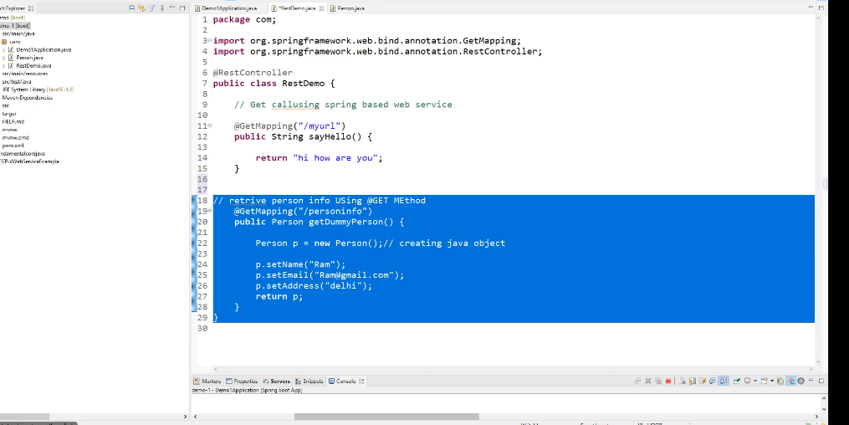

Slide 12
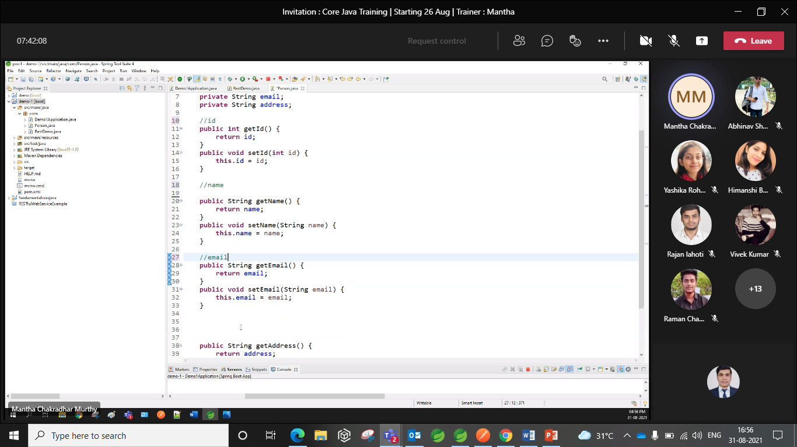

Slide 13
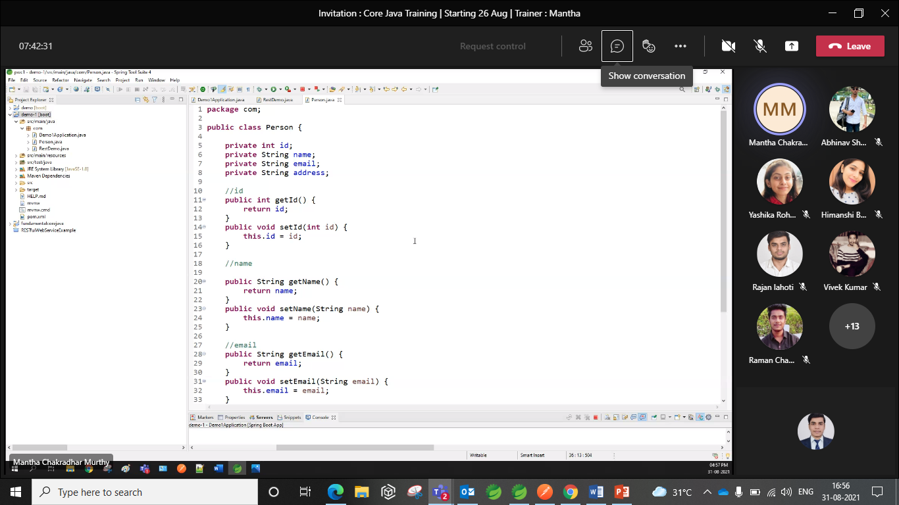

Slide 14
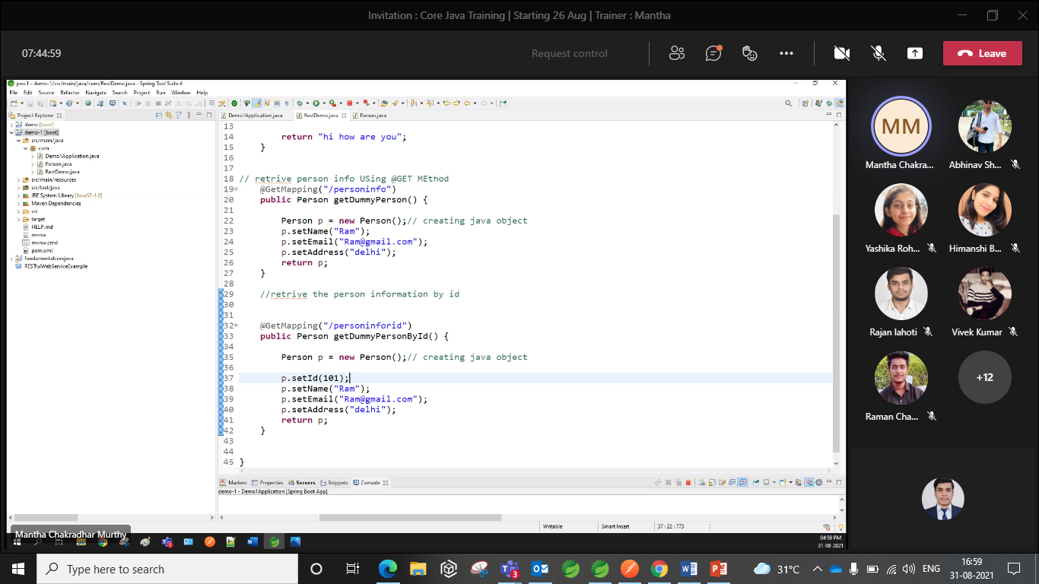

Slide 15
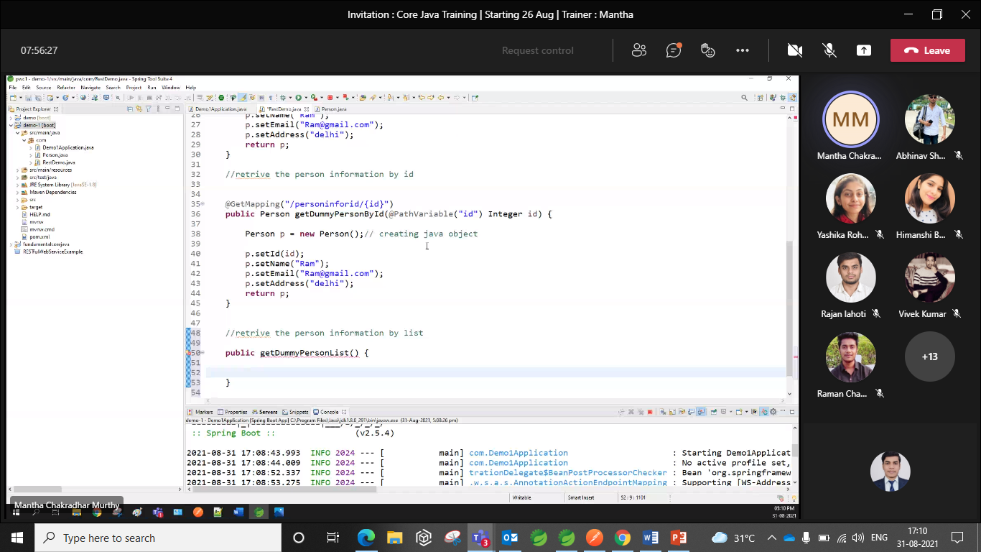

Slide 16
